Slide 1

Phishing Attacks: A Comprehensive Guide
Phishing attacks are a growing threat, exploiting trust and vulnerability to steal sensitive information. This presentation will guide you through understanding phishing tactics, recognizing suspicious activities, and protecting yourself from these malicious attempts.
by Muhammad Hamza

Slide 2

Understanding Phishing Tactics
Phishing attacks often mimic legitimate sources, tricking unsuspecting individuals into divulging personal data. This can include emails, websites, or even social media messages that appear authentic but are designed to deceive.
1
Email Spoofing
Phishing emails often forge sender addresses to make them appear legitimate, mimicking trusted organizations or individuals.
2
Urgency and Fear
Phishing attacks often create a sense of urgency or fear, pressuring victims to act quickly without thinking critically.
3
Social Engineering
Phishers may use social engineering techniques to manipulate victims into revealing sensitive information, exploiting trust and human psychology.

Slide 3
Recognizing Phishing Emails
Phishing emails often have telltale signs that can help you identify them. These indicators can include unusual sender addresses, suspicious links, and generic greetings or requests.
Suspicious Sender Address
Suspicious Links
Grammatical Errors and Urgent Tone
Hover over links before clicking to see the actual URL. Phishing links often lead to websites that look similar but are not legitimate.
Check the sender address carefully. It might be misspelled, contain unusual characters, or not match the name of the organization.
Phishing emails often contain grammatical errors or use an urgent tone, attempting to pressure you into taking action without thinking.

Slide 4

Identifying Suspicious Websites
Phishing websites often attempt to mimic the look and feel of legitimate websites, but there are key differences to watch out for. These include misspellings, questionable design, and unusual security features.
Misspelled Words and Unusual Design
Pay attention to spelling and design elements. Phishing websites often have misspellings, inconsistent design, or look unprofessional.
Unsecured Connection
Look for a padlock icon in the address bar and check the URL for "https" before entering sensitive information. This indicates a secure connection.
Fake Security Badges
Be wary of websites displaying fake security badges or certifications. Legitimate organizations have verifiable security credentials.

Slide 5

Social Engineering Techniques
Phishers often use social engineering tactics to gain trust and manipulate victims into revealing information. They may create a sense of urgency, appeal to emotions, or impersonate trusted individuals.
1
Authority
Phishers may impersonate authorities or officials to gain credibility and pressure you into following their instructions.
2
Scarcity
Phishers may create a sense of scarcity, suggesting that you need to act quickly to avoid missing out on an opportunity.
3
Intimidation
Phishers may use intimidation tactics, threatening consequences if you don't comply with their requests.
4
Curiosity
Phishers may pique your curiosity with enticing offers, leading you to click on suspicious links or reveal sensitive information.

Slide 6


Protecting Yourself from Phishing
Protecting yourself from phishing attacks involves a combination of awareness, caution, and best practices. By understanding phishing tactics and taking proactive measures, you can minimize your risk of falling victim to these attacks.
Strong Passwords
Two-Factor Authentication
Be Skeptical
Keep Software Updated
Use strong, unique passwords for all your online accounts, and consider using a password manager.
Be cautious of unsolicited emails, phone calls, or messages that ask for personal information, and always verify before sharing anything.
Enable two-factor authentication whenever possible, adding an extra layer of security to your accounts.
Regularly update your operating system and software to patch security vulnerabilities and protect against malware.

Slide 7





Best Practices for Email Security
Follow these best practices for email security to minimize your risk of falling victim to phishing attacks. These practices emphasize vigilance, critical thinking, and responsible email management.
Verify Sender
Always verify the sender address and be cautious of unexpected emails from unknown sources.
Avoid Clicking Links
Hover over links to view the actual URL before clicking, and avoid clicking links in suspicious emails.
Report Phishing Emails
Report suspicious emails to your IT department or the relevant organization, helping to prevent others from falling victim.
Use Email Filters
Configure your email client's filters to block spam and phishing emails, automatically segregating suspicious messages.

Slide 8
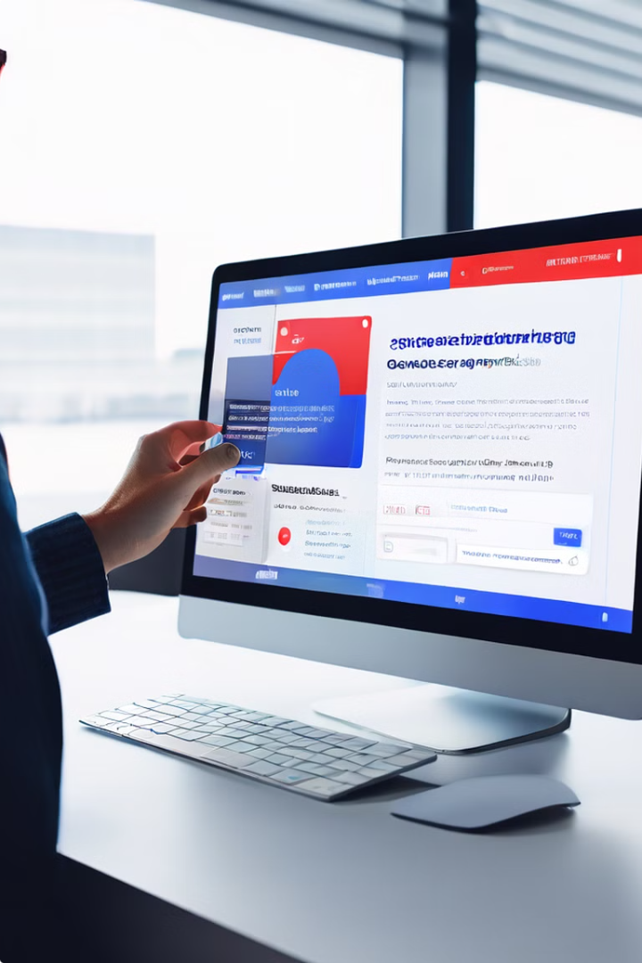
Reporting Phishing Attempts
Reporting phishing attempts is crucial for protecting yourself and others from falling victim to these attacks. By reporting these incidents, you help authorities track and address the problem effectively.
If you receive a suspicious email:
Report it to your IT department or the relevant organization.
If you encounter a suspicious website:
Report it to the website's owner or to the relevant authorities.
If you suspect a social engineering attempt:
Do not engage with the attacker and report the incident to the appropriate authorities or your IT department.

Slide 9



Educating Employees about Phishing
Educating employees about phishing is essential for any organization to protect its sensitive data and mitigate risks. By fostering awareness and providing training, you can equip employees with the knowledge and skills needed to identify and avoid these attacks.
Interactive Training Modules
Workshops and Group Discussions
Company-wide Awareness Campaigns
Engage employees with interactive training modules that simulate real-world phishing scenarios, helping them learn to identify suspicious activities.
Conduct workshops and group discussions to provide employees with a platform to share their experiences and learn from each other's insights.
Implement company-wide awareness campaigns to educate employees about phishing risks, providing tips and guidelines to protect themselves.

Slide 10

Conclusion and Key Takeaways
Phishing attacks are a constant threat, but by staying informed and taking preventive measures, you can effectively protect yourself and your organization from these malicious activities. This presentation has provided you with essential knowledge to recognize and avoid phishing attempts, ensuring your online safety and security.

Slide 11
Thank You!
For more information, please contact:
Muhammad Hamza
LinkedIn Profile:
linkedin.com/in/muhammadhamza012

